Slide 1
The Java Language
Value Types, Reference Types and Arrays

Slide 2
Creating Objects in Java
When we created objects in C++ I, we were creating an ifstream object called input on the stack.
ifstream input;
In Java, we create a File object on the heap. file is the reference to the object:
File file = new File(“Date.txt”);
file contains the address of the object created by the new operator and the constructor, File(“Date.txt”);
The object reference, file, is similar to a pointer in C++.
Java has Garbage collection. In C++, the programmer is responsible for memory management

Slide 3
Use the object to access the class methods
The Date class is a utility class that represents the current time. Here we create a new instance of Date with the new operator and call its getHours() method to retrieve the current hour as an integer value.
The Date object reference lives long enough to service the method call and is then cut loose and garbage-collected at some point in the future.
int hours = new Date().getHours();

Slide 4
Reference Types vs.Value Types

Slide 5
Value Types
Value types are what we have been using in C++ I.
When we pass a value type, we “pass by value.”
OK, never mind pointers and references. Their contents are not passed by value. But the addresses are.
Value types hold the value they represent in their memory.
Primitives (int, float, etc) are also passed by value.
Pass by value simply means that the value of the variable is copied.

Slide 6
Reference Types
In an object-oriented language like Java, you create new, complex data types from simple primitives by creating a class.
Each class is a new Type. Instances of the class are accessed by their reference variable, which gives us a name to access it.
The reference variable contains the address of the object and “points” to the location of the object on the heap.
Therefore, when we pass a reference type, only the reference is copied, not the object it is pointing to.

Slide 7
Object Initialization
Reference types always point to objects (or null), and objects are always defined by classes.
Similar to native types, instance or class variables that are not explicitly initialized when they are declared will be assigned the default value of null.
Also, like native types, local variables that have a reference type are not initialized by default so you must set your own value before using them.

Slide 8
Arrays

Slide 9
Simple Arrays
Simple arrays are used similarly to built-in arrays in C++.
The difference is that in Java, the arrays are object and are created using the new operator:
int[ ] monthDays = new int[12];
Once created, the array elements are accessed using their index as we have done before:
monthDays[1] = 28; //This is for February, since arrays are zero-indexed as usual.

Slide 10
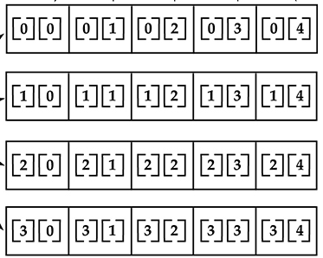
Multi-Dimensional Arrays
Two-dimensional array:
int[ ][ ] twoD = new int[4][5];
Internally, th.is matrix is implemented as an array of arrays of int.
There will be 4 rows and 5 columns
Conceptual Display

Slide 11
Specifying Dimensions
When you allocate memory for a multidimensional array, you need only specify the memory for the first (leftmost) dimension.
You can allocate the remaining dimensions separately.
Since multidimensional arrays are actually arrays of arrays, the length of each array is under your control. So they do not need to be square.

Slide 12
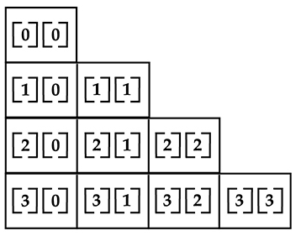
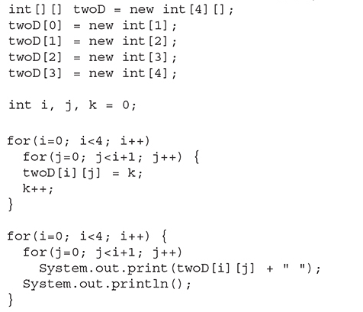
Uneven Two-Dimensional Array
Create and Display the array
This array looks like this:
Program output looks like this:
0
2
4 5
6 7 8 9

Slide 13
Arrays of Objects

Slide 14
Declaring Arrays of Objects
When we create an array of objects, it might look like this:
Auto[] cars = new Auto[3];
The left side declares the array. No memory is allocated for the array yet.
The right side instantiates the array and allocates memory.
If the array type is a primitive type, the array element values are defaulted to 0, 0.0, or false, depending on which type is used.

Slide 15
If the Array Elements are Objects
If the array type is a class, the elements of the array are only references and they are initialized with null.
They are currently NULL POINTERS!
So we must initialize them before we use them.

Slide 16
Initializing an Array of Objects
We can initialize the array at the time of declaration if we know what goes into the array:
public class Car {
private String make; // car's make
private int year; // car's manufacturing year
private String color; // car's primary color
}
Car sportsCar = new Car(“Corvette”, 2024, “Red”);
Car[ ] cars = {
new Car(“Lambo”, 2023, “Silver”),
new Car(),
sportsCar
};

Slide 17
Filling an Array of Objects
In order to get an actual Auto object into the array, we must instantiate one and then assign it:
Car sportsCar = new Car(“Ferrari”, 2022, “Blue”);
cars[0] = sportsCar;
Or we can assign anonymous objects:
cars[1] = new Car();

